Slide 1
Linear and binary search

Slide 2
Introduction to Searching Algorithms
Searching algorithms help find a specific element in a given data structure (array, list, etc.). Two basic types are:
Linear Search – Works on both sorted and unsorted data.
Binary Search – Only works on sorted data, but is more efficient.

Slide 3
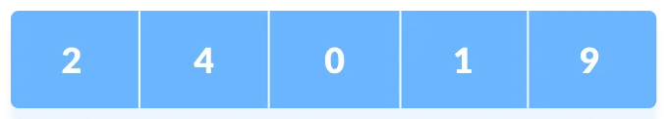
Linear Search
Linear search is a sequential searching algorithm where we start from one end and check every element of the list until the desired element is found.
It is the simplest searching algorithm.
If a match is found, return the index.
If the end of the array is reached without finding the element, return -1.
The following steps are followed to search for an element k=1 in the list below.

Slide 4
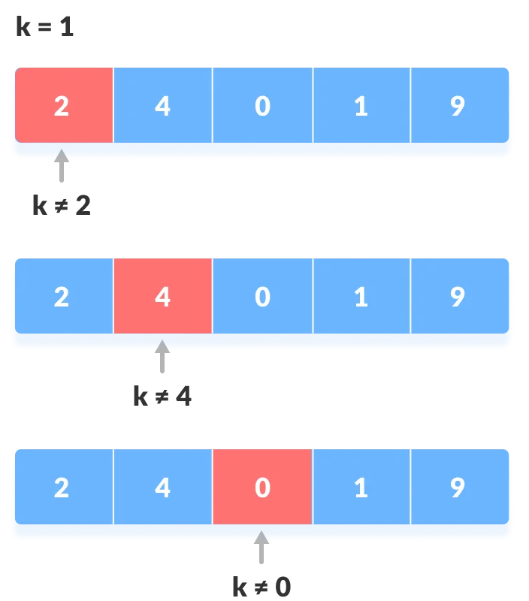
Linear Search
Start from the first element, compare k with each element of array.

Slide 5
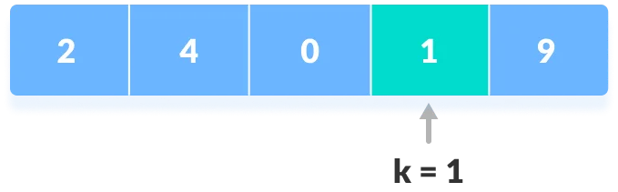
Linear Search
If x == k, return the index.
Else, return not found.

Slide 6
Linear Search Implementation
#include <iostream>
using namespace std;
int linearSearch(int arr[], int n, int target) {
for (int i = 0; i < n; i++) {
if (arr[i] == target) {
return i; // Element found, return index
}
}
return -1; // Element not found
}
int main() {
int arr[] = {10, 20, 30, 40, 50};
int n = sizeof(arr) / sizeof(arr[0]);
int target = 30;
int result = linearSearch(arr, n, target);
if (result != -1)
cout << "Element found at index " << result << endl;
else
cout << "Element not found" << endl;
return 0;
}

Slide 7
Linear Search Run-Time Analysis
Let 𝑛 be the number of elements in the array.
Case | Time Complexity | Explanation
Best Case | O(1) | When the target element is the first element.
Worst Case | O(n) | When the target element is the last element or not present.
Average Case | O(n) | On average, it will search half of the elements.

Slide 8
Binary Search
Binary Search is a searching algorithm for finding an element's position in a sorted array.
In this approach, the element is always searched in the middle of a portion of an array.
Binary search can be implemented only on a sorted list of items.
If the elements are not sorted already, we need to sort them first.

Slide 9
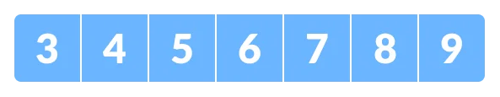
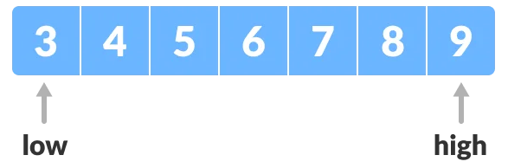
Binary Search
The array in which searching is to be performed is:
Let x=4 be the element to be searched.
Set two pointers low and high at the lowest and the highest positions respectively.

Slide 10
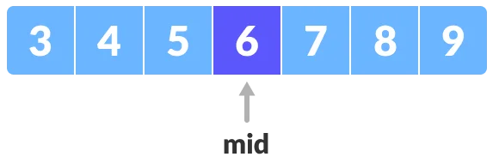
Binary Search
Find the middle element mid of the array i.e. arr[(low+high)/2] = 6
If x == mid, then return mid. Else, compare the element to be searched with other elements of array.

Slide 11
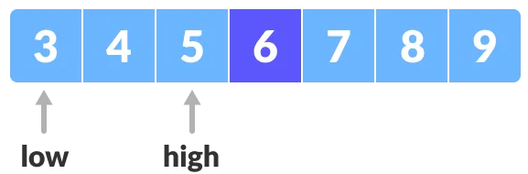
Binary Search
If x > mid, compare x with the middle element of the elements on the right side of mid. This is done by setting low to low = mid + 1;
Else, compare x with the middle element of the elements on the left side of mid. This is done by setting high to high = mid -1;

Slide 12
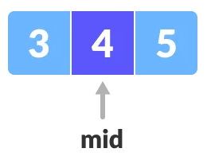
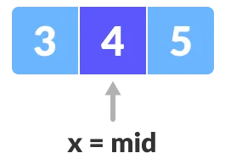
Binary Search
Repeat steps 3 to 6 until low meets high.
x = 4 is found.

Slide 13
Binary Search Implementation
#include <iostream>
using namespace std;
int binarySearch(int arr[], int low, int high, int target) {
while (low <= high) {
int mid = (low + high) / 2;
if (arr[mid] == target)
return mid; // Target found
if (arr[mid] < target)
low = mid + 1; // Search in the right half
else
high = mid - 1; // Search in the left half
}
return -1; // Element not found
}
int main() {
int arr[] = {10, 20, 30, 40, 50};
int n = sizeof(arr) / sizeof(arr[0]);
int target = 30;
int result = binarySearch(arr, 0, n - 1, target);
if (result != -1)
cout << "Element found at index " << result << endl;
else
cout << "Element not found" << endl;
return 0;
}

Slide 14
Binary Search Run-Time Analysis
Let 𝑛 be the number of elements in the array
Case | Time Complexity | Explanation
Best Case | O(1) | If the middle element is the target.
Worst Case | O(log n) | The search space reduces by half in each step.
Average Case | O(log n) | Similar to the worst case as we always divide the array.

